Slide 1

PyCon Taiwan 2013 Tutorial
林信良（Justin Lin）
caterpillar@openhome.cc
http://openhome.cc

Slide 2
Course Objectives
Learning Python ecosystem
languages, tools, libraries…
Understanding core culture of Python communities
coding styles, paradigms, documents, communities …
Making a connection with PyConTW 2013

Slide 3
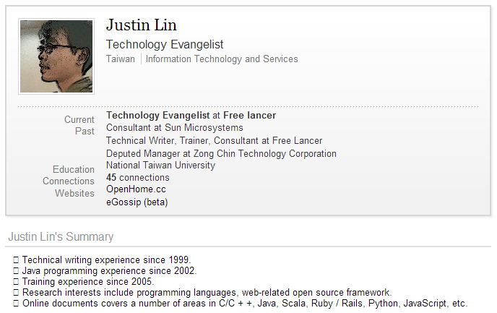
Instructor？
http://www.linkedin.com/in/caterpillar

Slide 4

Student？
PyCon Taiwan 2013 Tutorial Invitation
”．．．
對我而言，要瞭解語言後的文化與生態系，約莫是三到六個月的時間，若以我至三月中前對 Python 生態系的瞭解過程與心得，配合 PyConTW 的議程，將之濃縮為六個小時的課程，你覺得如何？
．．．“
(Understanding cultures and ecosystem of a language takes me about three to six months. How about wrapping up what I have learned from Python ecosystem before mid-March and considering the agenda of PyConTW to build up a six-hour course?)

Slide 5
Schedule
The 1st class
Preface (currently here)
Picking and installing an Interpreter
Implementations
Preparing course environment
Where’re my libraries?
What’s the relationship among distutils, Distribute and Pip?
Hello! World!
Introduction to Unicode Support
Basic Input and Output
Integrated Development Environment
Reference

Slide 6
The 2nd class
Learning Python language
Built-in Types
Numerical Types
String Type
List Type
Set Type
Dict Type
Tuple Type
if, for, while and for Comprehensions
if..else
for and while
for Comprehensions
Functions, Modules, Classes and Packages
Functions
Modules
Classes
Packages
References

Slide 7
The 3rd class
The Community
Documentation
DocStrings
Official Documentation
PyDoc
EpyDoc
Data Management Functions
Built-in Functions
reduce
Persistence
marshal, pickle, cPickle
DBM
shelve
DB-API 2.0（PEP 249）
References

Slide 8
The 4th class:
Libraries vs Frameworks
Inversion of Control
Do We Need a Framework?
Getting Started with Django
Creating a Project
Creating a Database and an App
Playing API with the Python shell
Writing Your First View
Controller? or Views?
URLconf
References

Slide 9
The 5th class
Using the Template System
Writing Templates
Removing Hardcoded URLs in Templates
Namespacing URL Names
Writing a Simple Form
A Bit About CSRF
A Cross-Site Request Forgery Example
CSRF Countermeasures
Testing
assert
doctest
References

Slide 10
The 6th class
unittest（Testing Continued）
ToDo…
Profiling
timeit
cProfile
References

Slide 11
Picking and installing an Interpreter
2.x vs 3.x
Python 3.0 (a.k.a. "Python 3000" or "Py3k") final was released on December 3rd, 2008.
Python 3.3.0 was released on September 29th, 2012.
Python 2.7.3 was released on April 9, 2012.
Python 2.7.x is highly recommended unless you have a strong reason not to.
As more and more modules get ported over to Python3, the easier it will be for others to use it.

Slide 12
Implementations
CPython（http://www.python.org）
Written in C.
Compiles Python code to intermediate bytecode.
Provides the highest level of compatibility with Python packages and C extension modules.
PyPy（http://pypy.org）
Features a JIT (just-in-time) compiler.
Aims for maximum compatibility with the reference CPython implementation while improving performance.

Slide 13
Jython（http://www.jython.org/）
An implementation of Python for the JVM.
Compiles Python code to Java byte code.
Can import and use any Java class the same as a Python module.
IronPython（http://ironpython.net/）
An open-source implementation of the Python programming language which is tightly integrated with the .NET Framework.
Can use the .NET Framework and Python libraries.
Other .NET languages can use Python code just as easily.

Slide 14
Preparing Course Environment
Ubuntu 12.04 LTS
Python 2.7.3
Distribute
Pip
Virtualenv

Slide 15
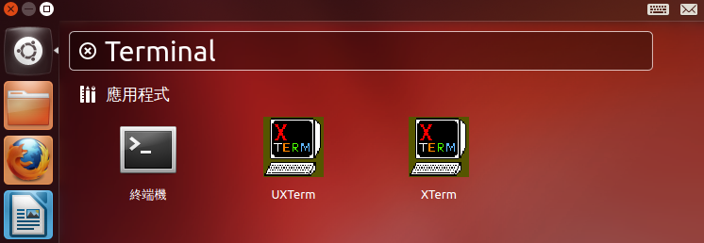
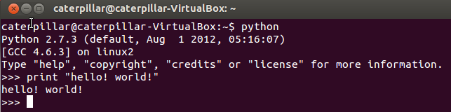
Exercise 0
Installing Python 2.7.3
Ubuntu 12.04 comes with Python 2.7.3 out of the box.
All you have to do is to open a terminal and python!

Slide 16
Exercise 1
Installing Distribute, Pip and Virtualenv
Distribute extends the packaging and installation facilities provided by the distutils in the standard library.
run the python script available below:
http://python-distribute.org/distribute_setup.py
~$ mkdir scripts
~$ cd scripts
~/scripts$ wget http://python-distribute.org/distribute_setup.py
~/scripts$ sudo python distribute_setup.py

Slide 17
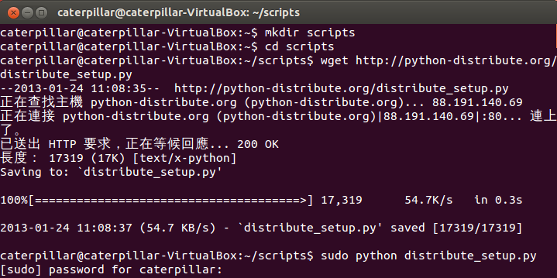
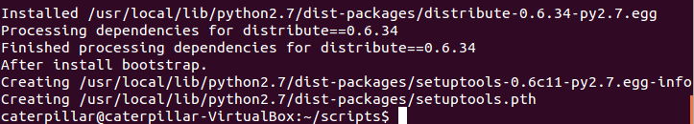
What You Should See
~

Slide 18
The new``easy_install`` command you have available is considered by many to be deprecated, so we will install its replacement: pip.
The virtualenv kit provides the ability to create virtual Python environments that do not interfere with either each other, or the main Python installation.
~/scripts$ sudo easy_install pip
~/scripts$ sudo pip install virtualenv

Slide 19
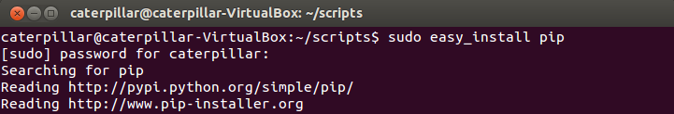
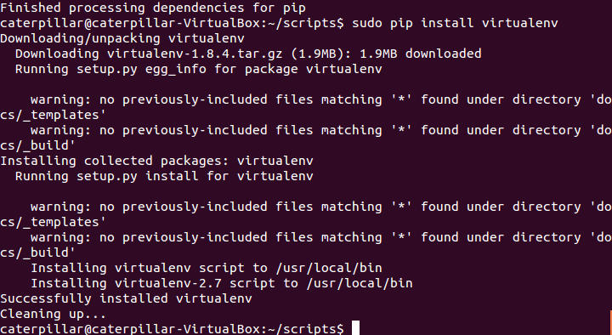
What You Should See
~

Slide 20
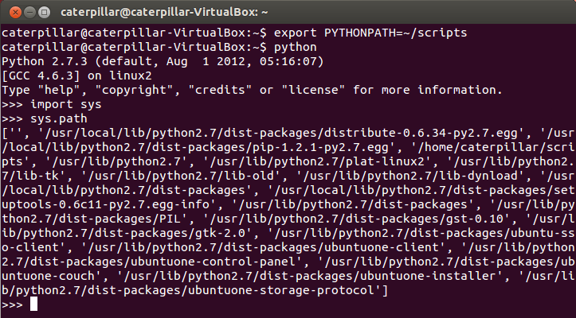
Where’re my libraries?
The sys.path is a list of strings that specifies the search path for modules.
Use the environment variable PYTHONPATH to augment the default search path for module files.

Slide 21
What’s the relationship among Distutils, Setuptools, Distribute and Pip?
Distutils
The Python standard library for building and installing additional modules.
For simple installation scenarios.
Basic steps:
Untar the downloaded file (e.g. tar xzvf Django-X.Y.tar.gz)
Change into the directory. Basically, all you need is setup.py.
sudo python setup.py install
Setuptools
Extends distutils.
De facto standard of Python community.
Has problems of slow development, messy code…

Slide 22
Distribute
Extends distutils.
Intended to replace Setuptools as the standard method for working with Python module distributions.
Providing a backward compatible version to replace Setuptools and make all distributions that depend on Setuptools work as before.
So, once setuptools or distribute is installed, easy_install is prepared.
The easy_install command is considered by many to be deprecated due to lack of unstallation command, svn-only support…
Pip
An easy_install replacement.
Allows for uninstallation of packages, and is actively maintained, unlike easy_install.
Virtualenv is its good partner.
Basic commands:
pip install [PACKAGE_NAME]
pip unstall [PACKAGE_NAME]

Slide 23
Hello! World!
The virtualenv kit provides the ability to create virtual Python environments that do not interfere with either each other, or the main Python installation.
Create a virtual Python environment:
virtualenv --distribute venv
Activate the environment:
source bin/activate
Deactivate the environment:
deactivate

Slide 24
Exercise 2
Create and activate a virtual Python environment.
Prompt a use to provide a filename, read the file and print the content in the terminal. Consider the character encoding problems.
~/scripts$ virtualenv --distribute venv
~/scripts$ cd venv
~/scripts/venv$ source bin/activate

Slide 25
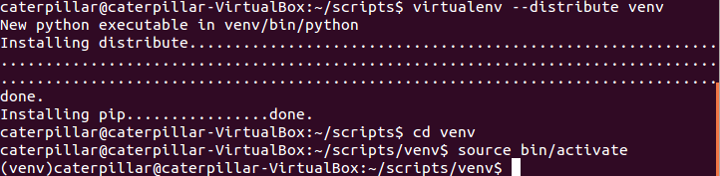
What You Should See

Slide 26
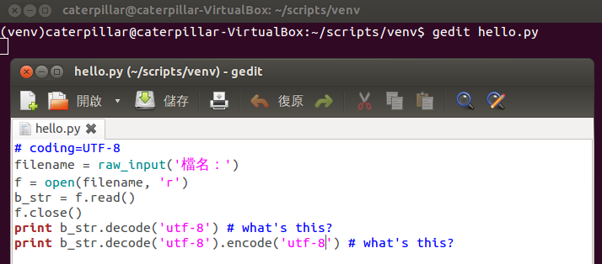
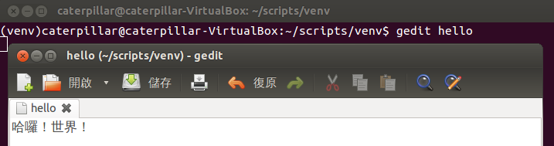
~/scripts/venv$ gedit hello.py
~/scripts/venv$ gedit hello

Slide 27
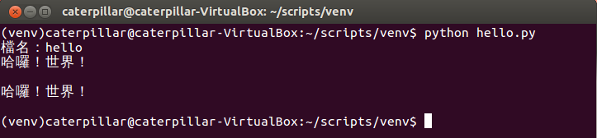
What You Should See

Slide 28
Introduction to Unicode Support
Default encoding of Ubuntu: UTF-8.
Python 2:
Strings are actual byte sequence representing the data.
Unicode literals are written as strings prefixed with the 'u' or 'U' character
encoding declaration
# coding=UTF-8
text = '測試'
print len(text) # print "6"
# coding=UTF-8
text = u'測試'
print type(text) # print "<type 'unicode'>"
print len(text) # print "2"

Slide 29
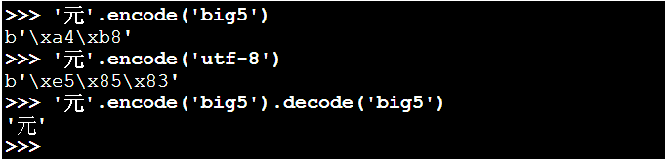
Python 2:
decode interprets the string using the given encoding and returns a unicode instance.
encode returns an 8-bit string version of the Unicode string.
Python 3: Unicode by default.
decode returns a bytes instance representing byte sequence.
encode returns a str instance representing the Unicode string.

Slide 30
Basic Input and Output
Read a file:
Write a file:
Import a module
import sys
file = open(sys.argv[1], 'r')
content = file.read()
print content
file.close()
Command line arguments
import sys
file = open(sys.argv[1], 'w')
file.write('test')
file.close()

Slide 31
Three ways for reading all content in a file:
import sys
file = open(sys.argv[1], 'r')
while True:
line = file.readline()
if not line: break
print line
file.close()
import sys
file = open(sys.argv[1], 'r')
for line in file.readlines():
print line
file.close()
import sys
for line in open(sys.argv[1], 'r'):
print line

Slide 32
Integrated Development Environment
Sometimes, it‘s just the problem of flavor.
PyCharm / IntelliJ IDEA
http://www.jetbrains.com/pycharm/
PyDev / Eclipse plugin
http://pydev.org/
Komodo IDE
http://www.activestate.com/komodo-ide
Spyder
http://code.google.com/p/spyderlib/
WingIDE
http://wingware.com/
NINJA-IDE
http://www.ninja-ide.org/
Python Tools for Visual Studio
http://pytools.codeplex.com/

Slide 33
References
Implementations
http://www.python.org/download/releases/3.0/
http://www.python.org/download/releases/2.7.3/
http://docs.python-guide.org/en/latest/starting/which-python/
Preparing course environment
http://docs.python-guide.org/en/latest/starting/install/linux/
Where’re my libraries?
http://docs.python.org/2/using/cmdline.html
What’s the relationship among distutils, Distribute and Pip?
http://docs.python.org/2/library/distutils.html
http://pypi.python.org/pypi/distribute
http://pypi.python.org/pypi/pip
http://blog.yangyubo.com/2012/07/27/python-packaging/
http://www.openfoundry.org/tw/tech-column/8536-introduction-of-python-extension-management-tools
Hello! World!
http://caterpillar.onlyfun.net/Gossip/Python/IOABC.html
http://caterpillar.onlyfun.net/Gossip/Encoding/
http://caterpillar.onlyfun.net/Gossip/Encoding/Python.html

Slide 34
Learning Python Language
What’re the most essential elements of a language?
How to encapsulate your code?
Focus on the essence of Python, not nuts and bolts.
Built-in types, variables and operators
Functions, classes and modules
Algorithms + Data Structures = Programs
-- Niklaus E. Wirth -- The chief designer of Pascal

Slide 35
Built-in Types
Every thing is an object.
Python, however, does not impose object-oriented programming as the main programming paradigm.
Numerical types
int, long, float, bool, complex
String type
Container types
list, set, dict, tuple

Slide 36
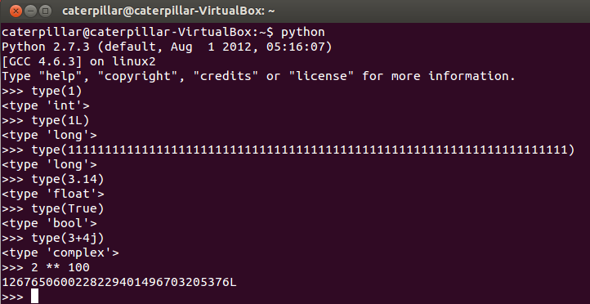
Numerical Types
int, long, float, bool, complex
The type function returns the type of any object.
Change to long type automatically

Slide 37
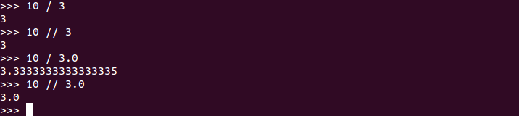
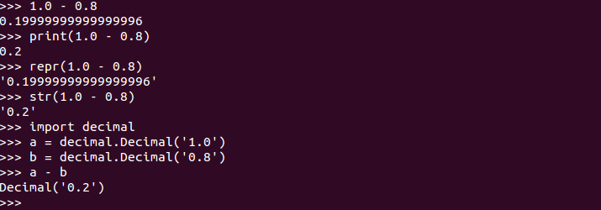
What You Should Know
Different results in different versions
Python float division:
Float decision, repr and str:
Call __repr__ function of an object
Call __str__ function of an object

Slide 38
__repr__ computes the “official” string representation of an object.
__str__ compute the “informal” string representation of an object.
__repr__ is to be unambigous and __str__ is to be readable.
The decimal module provides support for decimal floating point arithmetic.

Slide 39
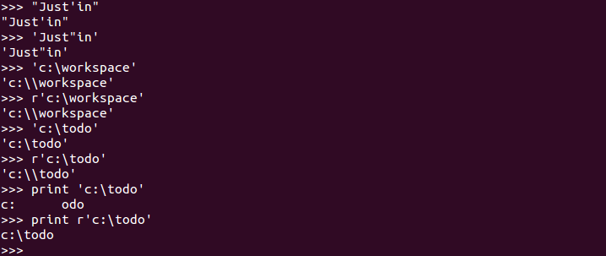
String Type
'' and "" are the same in Python and replaceable.
Use a raw string if you want to represent '\' itself.
A raw string

Slide 40
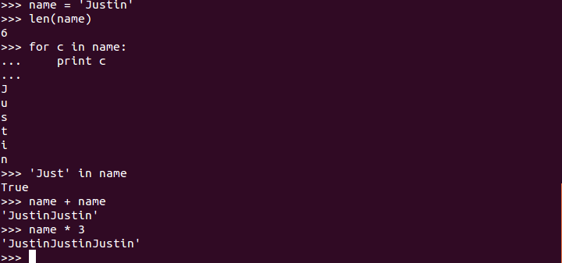
A string is immutable.
len returns the string length. Use for to iterate a string. in tests if a string contains a substring. + is for concatenating two strings. * replicates a string.

Slide 41
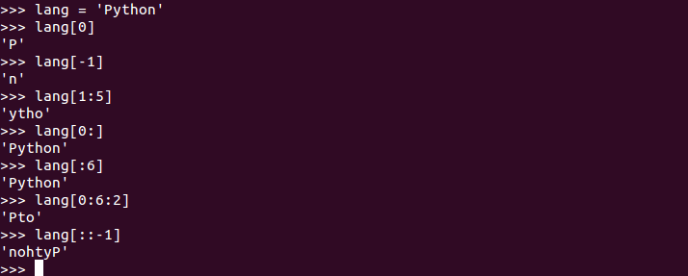
String Slicing
[] can specified an index to get a character from a string. A negative index is counted from the last element.
The most useful power of [] is slicing.
Begin, inclusive. 0 if omitted.
End, exclusive, the string length if omitted.
Gap
Reverse it

Slide 42

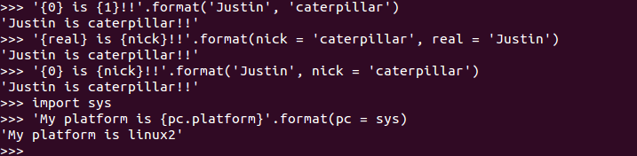
String Formatting
Old String Formatting Operations
New String Formatting Operations (after Python 2.6)

Slide 43
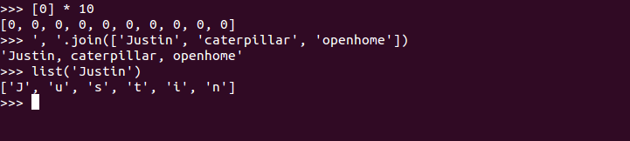
List Type
An ordered and mutable collection.
[1, 2, 3] creates a list with elements 1, 2, and 3 in the index 0, 1 and 2.
Shares common operations with strings.
len returns the list length. Use for to iterate a list. in tests if a list contains an element. + is for concatenating two lists. * replicates a list.
[] can specified an index to get a character from a string. A negative index is counted from the last element.
The most useful power of [] is slicing.
Initialize list values
Converting a list of strings to a string
Converting a string to a list

Slide 44
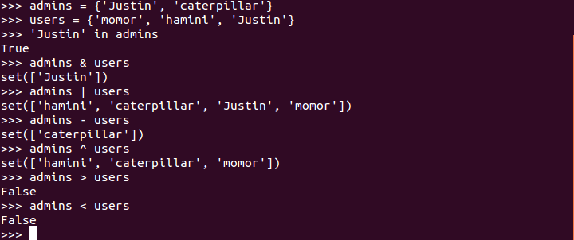
Set Type
A unordered collection. Contains no duplicate elements.
Elements should be immutable.
Exclusive or
∈

Slide 45
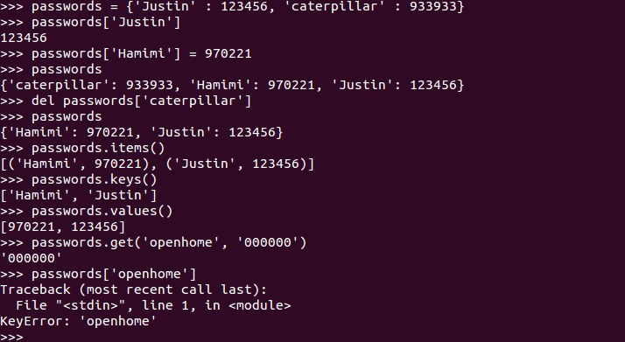
Dict Type
An object that maps keys to values.
A tuple
if 'openhome' in passwords:
return passwords['openhome']
else:
return '000000'

Slide 46
Tuple Type
A tuple is like a list, yet it’s immutable.
Shares common operations with lists.
In fact, sequences in Python (e.g. strings, lists, tuples, etc.) shares several features.
Mutable or immutable? We’ll talk about it soon…
(In Haskell - a statically-typed language - the types of elements in a tuple composes an unnamed type.)

Slide 47
Exercise 3
Open a terminal and type python. What will you see in the interactive shell if you type the following commands?
1 + 2
_
_ + 3
help()
len
keywords
quit(or simply q)
help(len)
Ctrl + D

Slide 48
After exiting the interactive shell, what will you see in the terminal if you type the following commands?
python -h
python -c 'print "Hello! Python!"‘
python -c 'help(len)‘
python -c 'import this‘
(Try anything you see from the previous slides about built-in types.)

Slide 49
if, for, while and for comprehensions
if..else block
if..else expression, something like the ternary operator ?: in C or Java.
from sys import argv
if len(argv) != 1:
print 'Hello, ' + argv[1]
else:
print 'Hello, Guest'
Below is a block
Indentation is important.
from sys import argv
print 'Hello, ' + (argv[1] if len(argv) != 1 else 'Guest')

Slide 50
for and while
Use for in to iterate a sequence.
Use while for undetermined conditions.
numbers = [10, 20, 30]
squares = []
for number in numbers:
squares.append(number ** 2)
print squares
print 'Enter two numbers...'
m = int(raw_input('Number 1: '))
n = int(raw_input('Number 2: '))
while n != 0:
r = m % n
m = n
n = r
print 'GCD: {0}'.format(m)

Slide 51
for comprehensions
With a list comprehension we can turn this:
Into this:
numbers = [10, 20, 30]
squares = []
for number in numbers:
squares.append(number ** 2)
print squares
numbers = [10, 20, 30]
print [number ** 2 for number in numbers]

Slide 52
With a list comprehension we can turn this:
Into this:
Flatten a list of lists.
numbers = [11, 2, 45, 1, 6, 3, 7, 8, 9]
odd_numbers = []
for number in numbers:
if number % 2 != 0:
odd_numbers.append(number)
print odd_numbers
numbers = [11, 2, 45, 1, 6, 3, 7, 8, 9]
print [number for number in numbers if number % 2 != 0]
lts = [[1, 2, 3], [4, 5, 6], [7, 8, 9]]
print [ele for lt in lts for ele in lt]

Slide 53

A set comprehension
A dict comprehension
(In Haskell, a set comprehension in mathematics can be written as [2 * x | x <- N, x <= 10] which looks similar to the set comprehension.)

Slide 54
Exercise 4
Turn the following code into a single statement.
(Here's a problem that combines tuple and list comprehensions: which right triangle that has integers for all sides and all sides equal to or smaller than 10 has a perimeter of 24?)
numbers = []
for number in range(20):
numbers.append(str(number))
print ", ".join(numbers)

Slide 55
Functions, Modules, Classes and Packages
In Python, everything is an object.
Does Python impose object-oriented programming as the main programming paradigm?
Points about structuring your program.
Encapsulation and separation of abstraction layers.
State of an object.
Namespace
Physical structures of your resources, such as source files, packages, etc.

Slide 56
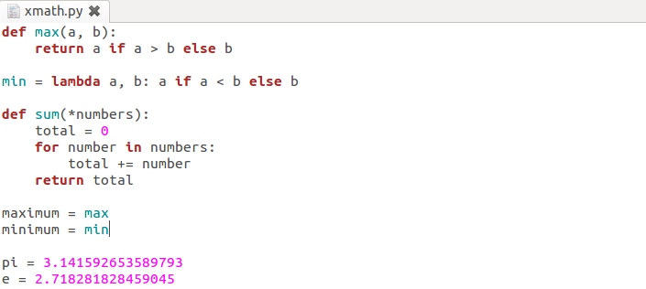
Functions
λ function
anonymous function
Variable arguments
Functions are first-class values.

Slide 57
Modules
What’s the best way to organize functions in the previous slide?
Modules are one of the main abstraction layers available and probably the most natural one.
A file named modu.py creates a module modu.
The import modu statement will look for modu.py in the same. If it isn’t found, the Python interpreter will search for modu.py in the sys.path recursively; or raise an ImportError exception if it isn’t found.

Slide 58
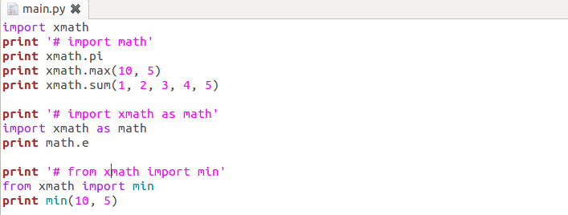
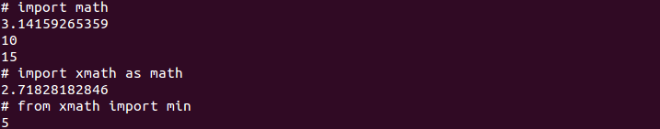
A module provides a namespace. The module’s variables, functions, and classes will be available to the caller through the module’s namespace
import, import as, from import are statements.
Create an alias
Copy it into the current module.
from modu import * is not recommended.

Slide 59
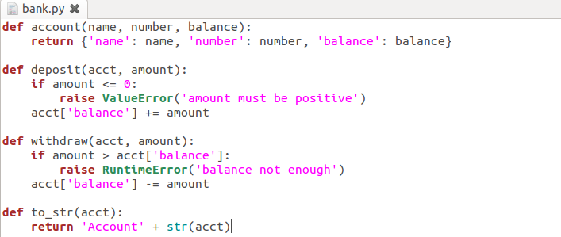
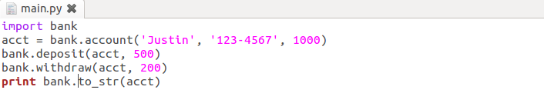
Classes
Well, where’s the playground for classes?
When we want to glue together some state and some functionality.

Slide 60
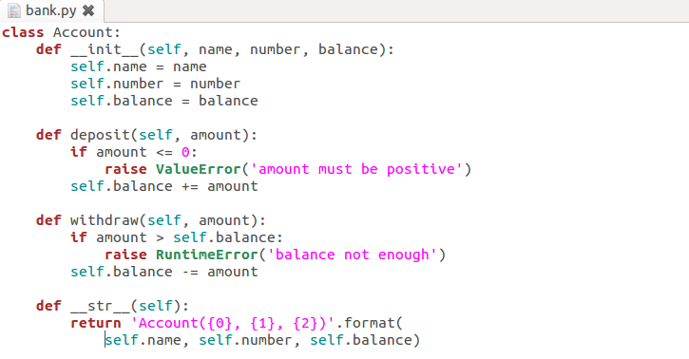
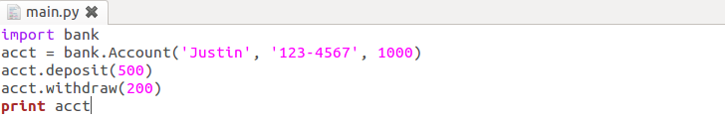
OOP is considering usability more than reusability.
Initializer
Explicit is better than implicit.
Still remember differences
between __str__ and __repr__?

Slide 61
Packages
Any directory with an __init__.py file - used to gather all package-wide definitions - is considered a package.
import pack.modu will looks for a file modu.py in the directory pack.
This statement will look for an __init__.py file in the directory pack, execute all of its top-level statements.
Then it will look for a file pack/modu.py and execute all of its top-level statements.
After these operations, any variable, function, or class defined in modu.py is available in the pack.modu namespace.

Slide 62
Exercise 5
There’s a quick and dirty main.py located in the /exercises/exercise5 of the lab file. Use modules, classes and packages learned in the previous slides to structure them as follow:
exercise5
main.py
pycon
__init__.py
xmath.py
bank.py

Slide 63
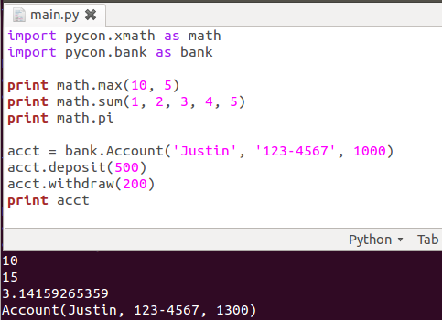
What You Should See?
Basically, you should have the following main.py and run it correctly.

Slide 64
References
String Type
http://docs.python.org/2/reference/datamodel.html#object.__repr__
http://docs.python.org/py3k/library/stdtypes.html#old-string-formatting
http://docs.python.org/py3k/library/string.html#string-formatting
List, Set, Dict, Tuple Types
http://caterpillar.onlyfun.net/Gossip/Python/ListType.html
http://caterpillar.onlyfun.net/Gossip/Python/SetType.html
http://caterpillar.onlyfun.net/Gossip/Python/DictionaryType.html
http://caterpillar.onlyfun.net/Gossip/Python/TupleType.html
Functions, Modules, Classes and Packages
http://caterpillar.onlyfun.net/Gossip/Python/Class.html
http://caterpillar.onlyfun.net/Gossip/Python/Class.html
http://docs.python-guide.org/en/latest/writing/structure/
Short Cuts
http://maxburstein.com/blog/python-shortcuts-for-the-python-beginner/

Slide 65

The Community
BDFL
Guido van Rossum（www.python.org/~guido）
The creator of Python, is often referred to as the Benevolent Dictator For Life.
PSF
Python Software Foundation（www.python.org/psf）
Its mission is to promote, protect, and advance the Python programming language, and to support and facilitate the growth of a diverse and international community of Python programmers.
A 501(c)(3) non-profit corporation that holds the intellectual property rights behind the Python programming language.

Slide 66
PEPs
Python Enhancement Proposals（www.python.org/dev/peps）
Describe changes to Python itself, or the standards around it.
Notable PEPs
PEP 1 -- PEP Purpose and Guidelines.
PEP 8 -- Style Guide for Python Code
PEP 20 -- The Zen of Python
PEP 257 -- Docstring Conventions
PyCon
Python Conference（www.pycon.org）
PyCon Taiwan（tw.pycon.org）
PIGgies
Python User Groups（wiki.python.org/moin/LocalUserGroups）
Taiwan Python User Group（wiki.python.org.tw）

Slide 67
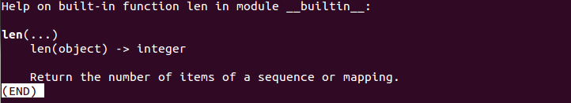
Documentation
What happens if you type len.__doc__ in the interactive shell?
Remember help? What’s the relationship between help(len) and len.__doc__?
Where’s len.__doc__ from?
Press ‘q’ to quit

Slide 68
DocStrings
Type the following code in the interactive shell.
Type max.__doc__ in the interactive shell.
Type help(max) in the interactive shell.
You’ll know what DocStrings are.
Remember to read PEP 257 if you want to comply with DocString Conventions.
def max(a, b):
'''max(a, b) -> value
With two arguments, return the largest argument.'''
return a if a > b else b

Slide 69
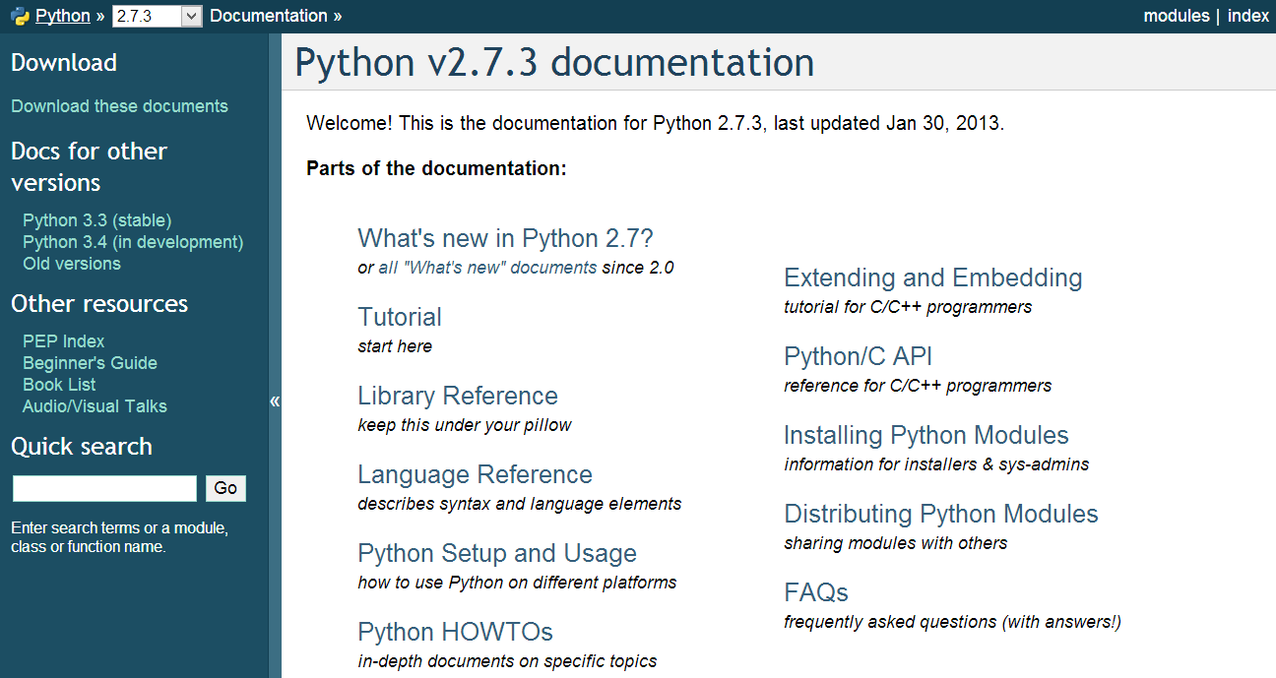
Official Documentation
docs.python.org
Python Module Index

Slide 70
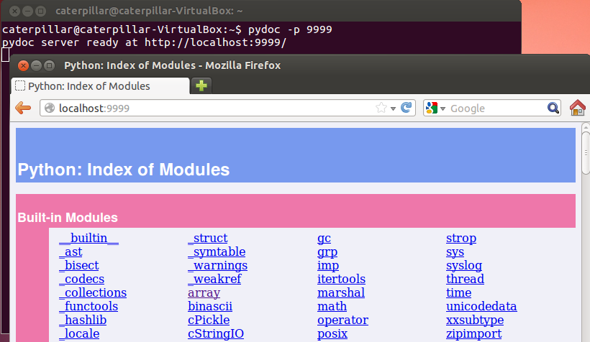
PyDoc
The pydoc module automatically generates documentation from Python modules.

Slide 71
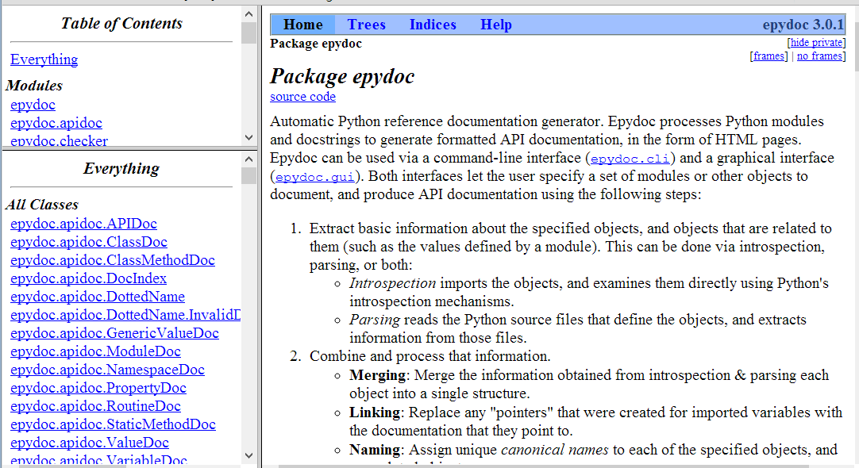
EpyDoc
Looks for something like JavaDoc?
epydoc.sourceforge.net

Slide 72

Data Management Functions
Built-in Functions（located in the __builtin__ module）
range(start, stop[, step])
zip([iterable, ...])
enumerate(sequence, start=0)
reduce(function, iterable[, initializer])

Slide 73
Exercise 6
How to iterate through a list with an index? For examples, given a list names = ['Justin', 'caterpillar', 'openhome'], print the followings.
Hints:
1. Fill in the blanks with proper codes.
2. Look up documentations about range, zip and enumerate.
0, Justin
1, caterpillar
2, openhome
names = ['Justin', 'caterpillar', 'openhome']
for ______ in ______:
print '{0}, {1}'.format(______)

Slide 74
reduce
Sometimes, it’s called foldLeft.
reduce(lambda acct, elem: acct + elem, [1, 2, 3, 4, 5], 0)
+
1
2
3
4
5
0

Slide 75
reduce
75
Sometimes, it’s called foldLeft.
reduce(lambda acct, elem: acct + elem, [1, 2, 3, 4, 5], 0)
+
2
3
4
5
1

Slide 76
reduce
76
Sometimes, it’s called foldLeft.
reduce(lambda acct, elem: acct + elem, [1, 2, 3, 4, 5], 0)
+
3
4
5
3

Slide 77
reduce
77
Sometimes, it’s called foldLeft.
reduce(lambda acct, elem: acct + elem, [1, 2, 3, 4, 5], 0)
+
4
5
6

Slide 78
reduce
78
Sometimes, it’s called foldLeft.
reduce(lambda acct, elem: acct + elem, [1, 2, 3, 4, 5], 0)
+
5
10

Slide 79
reduce
79
Sometimes, it’s called foldLeft.
reduce(lambda acct, elem: acct + elem, [1, 2, 3, 4, 5], 0)
15
5
5
5
5
5

Slide 80
reduce
reduce is a really versatile function that can be used in millions of different ways.
Once you want to calculate something from a list, consider using reduce instead of a for loop.

Slide 81
Exercise 7
Use reduce and list comprehensions to revise the following code (avaliable in lab/exercises/exercise7/main.py).
def ascending(a, b): return a - b
def descending(a, b): return -ascending(a, b)
# selection sort
def sorted(xs, compare = ascending):
return [] if not xs else __select(xs, compare)
def __select(xs, compare):
selected = xs[0]
for elem in xs[1:]:
if compare(elem, selected) < 0:
selected = elem
remain = []
selected_list = []
for elem in xs:
if elem != selected:
remain.append(elem)
else:
selected_list.append(elem)
return xs if not remain else selected_list + __select(remain, compare)
print sorted([2, 1, 3, 6, 5])
print sorted([2, 1, 3, 6, 5], descending)

Slide 82
Persistence
Object serialization
marshal, pickle, cPickle
DBM（Database Manager）
Simple “database” interface. Dbm objects behave like mappings (dictionaries) , except that keys and values are always strings.
shelve
A “shelf” is a persistent, dictionary-like object. The values can be essentially arbitrary Python objects.
DB-API 2.0（PEP 249）
Object-Relational Mapping（3rd-party libraries）
SQLAlchemy（www.sqlalchemy.org）
SQLObject（www.sqlobject.org）

Slide 83
marshal, pickle, cPickle
A more primitive serialization module is marshal. It exists primarily to support Python’s .pyc files.
In general, pickle should always be the preferred way to serialize Python objects.
It keeps track of the objects it has already serialized, so that later references to the same object won’t be serialized again.
It can serialize user-defined classes and their instances.
Its serialization format is guaranteed to be backwards compatible across Python releases.
cPickle is written in C, so it can be up to 1000 times faster than pickle.

Slide 84
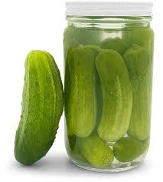
pickle
class DVD:
def __init__(self, title, year=None,
duration=None, director_id=None):
self.title = title
self.year = year
self.duration = duration
self.director_id = director_id
self.filename = self.title.replace(' ', '_') + '.pkl'
def check_filename(self, filename):
if filename is not None:
self.filename = filename

Slide 85
def save(self, filename=None):
self.check_filename(filename)
fh = None
try:
data = (self.title, self.year,
self.duration, self.director_id)
fh = open(self.filename, 'wb')
pickle.dump(data, fh)
except (EnvironmentError, pickle.PicklingError) as err:
raise SaveError(str(err))
finally:
if fh is not None:
fh.close()
def load(self, filename=None):
self.check_filename(filename)
fh = None
try:
fh = open(self.filename, 'rb')
data = pickle.load(fh)
(self.title, self.year,
self.duration, self.director_id) = data
except (EnvironmentError, pickle.PicklingError) as err:
raise LoadError(str(err))
finally:
...

Slide 86
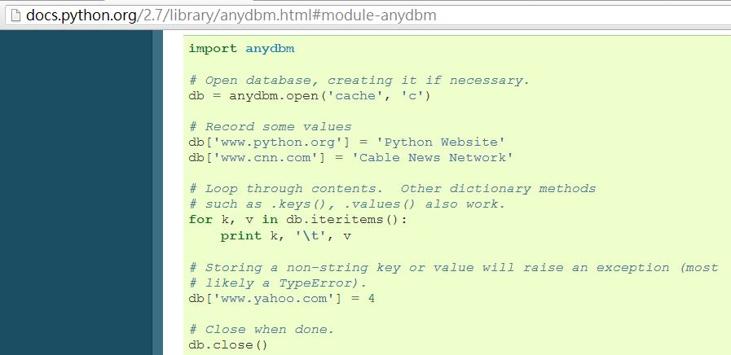
DBM
The dbm module provides an interface to the Unix “(n)dbm” library.

Slide 87
shelve
A “shelf” is a persistent, dictionary-like object. The difference with “dbm” databases is that the values (not the keys!) in a shelf can be anything that the pickle module can handle.
class DvdDao:
def __init__(self, shelve_name):
self.shelve_name = shelve_name
def save(self, dvd):
shelve_db = None
try:
shelve_db = shelve.open(self.shelve_name)
shelve_db[dvd.title] = (dvd.year,
dvd.duration, dvd.director_id)
shelve_db.sync()
finally:
if shelve_db is not None:
shelve_db.close()

Slide 88
def all(self):
shelve_db = None
try:
shelve_db = shelve.open(self.shelve_name)
return [DVD(title, *shelve_db[title])
for title in sorted(shelve_db, key=str.lower)]
finally:
if shelve_db is not None:
shelve_db.close()
return []
def load(self, title):
shelve_db = None
try:
shelve_db = shelve.open(self.shelve_name)
if title in shelve_db:
return DVD(title, *shelve_db[title])
finally:
if shelve_db is not None:
shelve_db.close()
return None

Slide 89
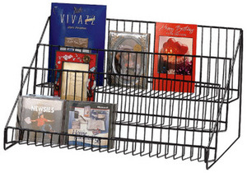
def remove(self, title):
shelve_db = None
try:
shelve_db = shelve.open(self.shelve_name)
del shelve_db[title]
shelve_db.sync()
finally:
if shelve_db is not None:
shelve_db.close()

Slide 90
DB-API 2.0（PEP 249）
The sqlite3 module provides a SQL interface compliant with the DB-API 2.0.
dvds
directors
id
title
year
duration
director_id
id
name

Slide 91
def connect(name):
create = not os.path.exists(name)
conn = sqlite3.connect(name)
if create:
cursor = conn.cursor()
cursor.execute("CREATE TABLE directors ("
"id INTEGER PRIMARY KEY AUTOINCREMENT UNIQUE NOT NULL, "
"name TEXT UNIQUE NOT NULL)")
cursor.execute("CREATE TABLE dvds ("
"id INTEGER PRIMARY KEY AUTOINCREMENT UNIQUE NOT NULL, "
"title TEXT NOT NULL, "
"year INTEGER NOT NULL, "
"duration INTEGER NOT NULL, "
"director_id INTEGER NOT NULL, "
"FOREIGN KEY (director_id) REFERENCES directors)")
conn.commit()
return conn

Slide 92
def add_dvd(conn, title, year, duration, director):
director_id = get_and_set_director(conn, director)
cursor = conn.cursor()
cursor.execute("INSERT INTO dvds "
"(title, year, duration, director_id) "
"VALUES (?, ?, ?, ?)",
(title, year, duration, director_id))
conn.commit()
def get_and_set_director(conn, director):
director_id = get_director_id(conn, director)
if director_id is not None:
return director_id
cursor = conn.cursor()
cursor.execute("INSERT INTO directors (name) VALUES (?)",
(director,))
conn.commit()
return get_director_id(conn, director)
def get_director_id(conn, director):
cursor = conn.cursor()
cursor.execute("SELECT id FROM directors WHERE name=?",
(director,))
fields = cursor.fetchone()
return fields[0] if fields is not None else None

Slide 93
def all_dvds(conn):
cursor = conn.cursor()
sql = ("SELECT dvds.title, dvds.year, dvds.duration, "
"directors.name FROM dvds, directors "
"WHERE dvds.director_id = directors.id"
" ORDER BY dvds.title")
cursor.execute(sql)
return [(str(fields[0]), fields[1], fields[2], str(fields[3]))
for fields in cursor]
def all_directors(conn):
cursor = conn.cursor()
cursor.execute("SELECT name FROM directors ORDER BY name")
return [str(fields[0]) for fields in cursor]

Slide 94
Exercise 8
There’re three incomplete source files located in lab/exercises/exercise8. Choose what you are interested in and complete it.
All code you need were listed in the previous slides.

Slide 95
References
The Community
www.python.org/~guido/
http://www.python.org/psf/
http://www.python.org/dev/peps/
http://www.pycon.org/
http://wiki.python.org/moin/LocalUserGroups/
Documentation
http://docs.python.org/2.7/
http://docs.python.org/2/library/pydoc.html
Data Management Functions
http://docs.python.org/2.7/library/functions.html
Persistence
http://docs.python.org/2/library/pickle.html
http://docs.python.org/2.7/library/dbm.html
http://docs.python.org/2/library/shelve.html
http://docs.python.org/2.7/library/sqlite3.html

Slide 96
Libraries vs Frameworks
What is the difference between a framework and a library?
Using libraries, your code is in control: it decides when to ask questions, when to read responses, and when to process those results.
name = raw_input('What is your name?')
process_name(name)
quest = raw_input('What is your quest?')
process_quest(quest)

Slide 97
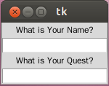
Using frameworks, it decides when to call your methods, based on the bindings you made when creating the form. The control is inverted - it calls you rather you calling the framework.
import Tkinter
top = Tkinter.Tk()
Tkinter.Label(top, text='What is Your Name?').pack()
name_var = Tkinter.StringVar()
name_entry = Tkinter.Entry(top, textvariable=name_var)
name_entry.pack()
name_entry.bind('<FocusOut>', lambda event: process_name(name_var))
Tkinter.Label(top, text='What is Your Quest?').pack()
quest_var = Tkinter.StringVar()
quest_entry = Tkinter.Entry(top, textvariable=quest_var)
quest_entry.pack()
quest_entry.bind('<FocusOut>', lambda event: process_name(quest_var))
Tkinter.mainloop()

Slide 98
Inversion of Control
Using libraries
Using frameworks
lib1
lib2
lib3
You control the flow.
lib5
lib4
comp1
comp2
The framework controls the flow.
comp4
comp3

Slide 99

Do We Need a Framework?
Libraries bring developers freedom.
Frameworks bring developers constraints.
Do we need a framework?
Do we want to follow the flow?
Do we make decisions according to technical reasons, or business reasons?
A right framework brings you a heaven; the wrong one brings you a hell.

Slide 100

Getting Started with Django
Django (www.djangoproject.com) is a high-level Python Web framework that encourages rapid development and clean, pragmatic design.
Object-relational mapper
Automatic admin interface
Elegant URL design
Template system
Cache system
Internationalization

Slide 101
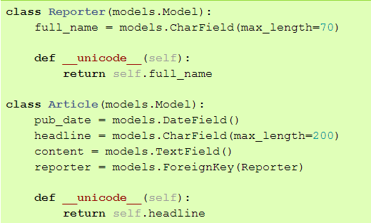
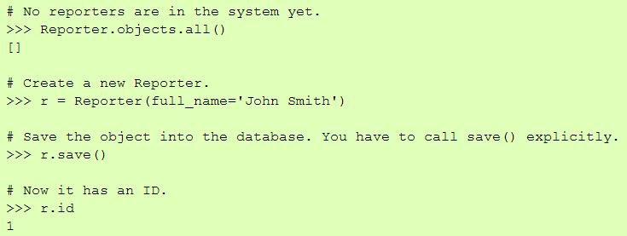
Design Your Models

Slide 102
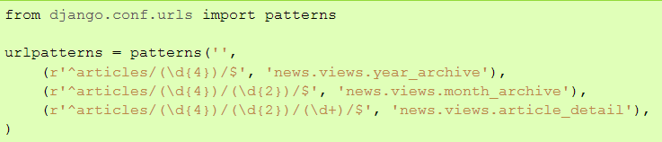
Design Your URLs

Slide 103
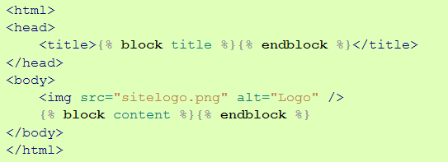
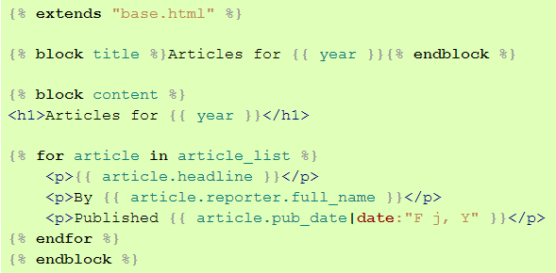
Write Your Views and Templates

Slide 104
Creating a Project（Exercise 9）
We’d like to install an offical realse of Django 1.5 rc1 with pip under a virtual Python environment provided by virtualenv. And Then, create our first django project.
~/scripts$ virtualenv --distribute venv
~/scripts$ cd venv
~/scripts/venv$ source bin/activate
~/scripts/venv$ pip install https://www.djangoproject.com/download/1.5c1/tarball/
~/scripts/venv$ python -c 'import django; print django.get_version()‘
~/scripts/venv$ django-admin.py startproject mysite
~/scripts/venv$ ls -al mysite
~/scripts/venv$ cd mysite
~/scripts/venv$ python manage.py runserver

Slide 105
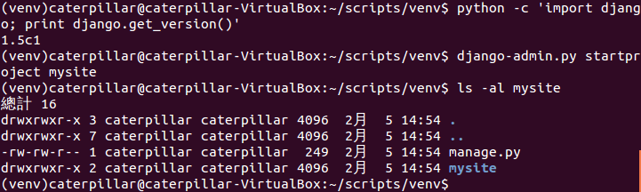
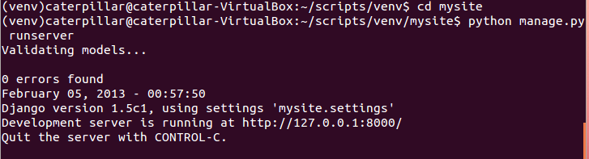
What You Should See

Slide 106
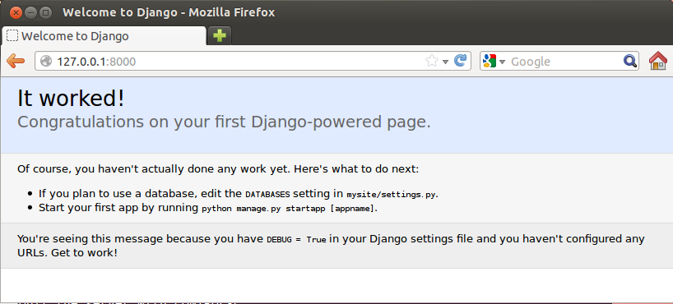
What You Should See

Slide 107
What startproject Created
You can rename it to anything you like.
A command-line utility that lets you interact with this project
mysite
manage.py
The actual Python package for your project.
mysite
__init__.py
Settings/configuration for this project.
settings.py
urls.py
The URL declarations for this project
Django’s primary deployment platform is WSGL.
wsgi.py
An entry-point for WSGI-compatible webservers to serve your project.

Slide 108
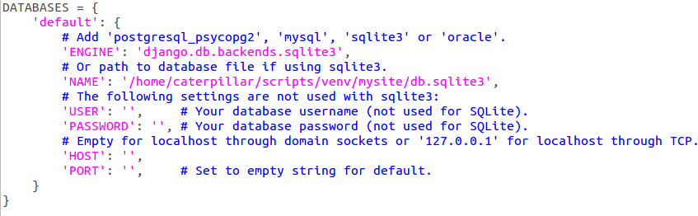
Creating a Database and an App（Exercise 10）
Edit mysite/settings.py. Change the following keys in the DATABASES 'default' item to match your database connection settings.
python manage.py syncdb

Slide 109
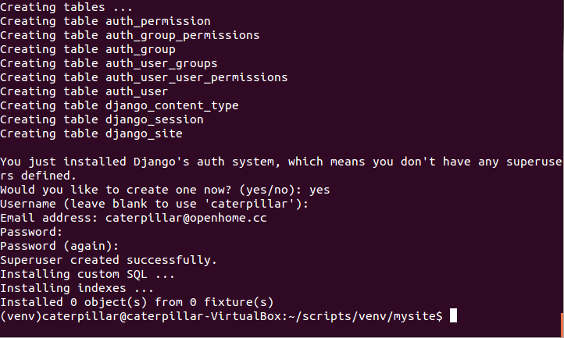
What You Should See

Slide 110
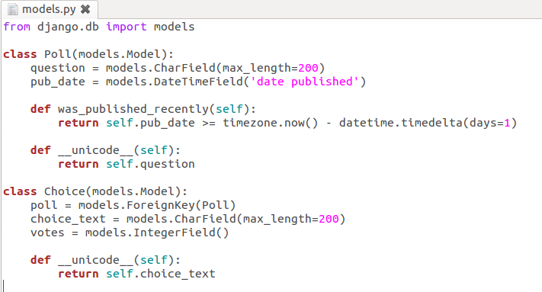
Type the following command to create a simple poll app.
python manage.py startapp polls
Edit the polls/models.py so it looks like this:
polls
__init__.py
models.py
tests.py
views.py

Slide 111

Edit the settings.py again, and change the INSTALLED_APPS setting to include the string 'polls'.
Type the following command to create tables for the polls app.
python manage.py sql polls
python manage.py syncdb

Slide 112


What You Should See

Slide 113
Playing API with the Python shell
Type the following command to set the DJANGO_SETTINGS_MODULE environment variable, which gives Django the Python import path to your settings.py file.
python manage.py shell

Slide 114

Basic ORM

Slide 115


One-to-One Relationship

Slide 116

Writing Your First View（Exercise 11）
Let’s write your first view. Open the file polls/views.py and put the following Python code in it:

Slide 117


Create a file called urls.py in the polls directory. Include the following code:
Open urls.py in the mysite directory. Include the following code:

Slide 118
Type the following command to start the Django development server.
python manage.py runserver
Visit the following urls with your browser.
http://localhost:8000/polls/
http://localhost:8000/polls/5/
http://localhost:8000/polls/5/results/
http://localhost:8000/polls/5/vote/

Slide 119




What You Should See

Slide 120
Controllers or Views?
We are using Django MVC framework. Are functions index, details, results and vote belong to controllers or views?
Well, the standard names are debatable.
In Django’s case, a “view” is the Python callback function for a particular URL.
Where does the “controller” fit in, then? In Django’s case, it’s probably the framework itself.
As you’ll see soon, you might say that Django is a MTV framework – that is, “Model”, “Template”, and “View”.

Slide 121
(Is there before_filter in Django as in Rails?
No. before_, around_ and after_ filter concepts aren't present in Django.
It’s not hard to hard-code what you need. Or, you can use a generic decorator, such as those provided by the Django authentication system.)

Slide 122
URLconf
Determining which view is called is done by Python modules informally titled ‘URLconfs’.
These modules are pure Python code and are a simple mapping between URL patterns to Python callback functions (your views).
The url() function needs two required arguments and one suggested argument.
regex: URL patterns are simple regular expressions.
view: When Django finds a regular expression match, Django calls the specified view function, with an HttpRequest object as the first argument and any “captured” values from the regular expression as other arguments.
name: Naming your URL lets you refer to it unambiguously from elsewhere in Django especially templates.

Slide 123
Simple URL Patterns
For urlpatterns in mysite/urls.py.
Any request starting with “/polls/
url(r'^polls/', include('polls.urls'))
Drop “/polls/” and use the remaining to match patterns defined in the polls.urls module.

Slide 124
For urlpatterns in polls/urls.py.
An empty string
Call the views.index function
url(r'^$', views.index)
The remaining represents an number, capture it as poll_id
url(r'^(?P<poll_id>\d+)/$', views.detail)
Call the views.details function. The second argument is the captured poll_id.
url(r'^(?P<poll_id>\d+)/results/$', views.results)
Starting with an number and ends with “/results/”

Slide 125
References
Libraries vs Frameworks
http://martinfowler.com/bliki/InversionOfControl.html
Getting Started with Django
https://docs.djangoproject.com/en/1.5/intro/overview/
https://docs.djangoproject.com/en/1.5/
https://docs.djangoproject.com/en/1.5/intro/install/
http://stackoverflow.com/questions/12339608/installing-django-1-5development-version-in-virtualenv
https://docs.djangoproject.com/en/1.5/intro/tutorial01/
Writing Your First View
https://docs.djangoproject.com/en/1.5/intro/tutorial03/
https://docs.djangoproject.com/en/dev/faq/general/#django-appears-to-be-a-mvc-framework-but-you-call-the-controller-the-view-and-the-view-the-template-how-come-you-don-t-use-the-standard-names
https://docs.djangoproject.com/en/1.5/topics/auth/default/

Slide 126

Using the Template System
Edit the Python code to change the way the page looks? We don’t want to back to the spaghetti world.
Let’s use Django’s template system to separate the design from Python.
Tags control the logic of the template.
Context variables, dot-lookup syntax

Slide 127

Writing Templates（Exercise 12）
Create a directory called templates in your polls directory. Django will look for templates in there.
Create another directory called polls, and within that Create a file called index.html.
In other words, your template should be at polls/templates/polls/index.html.
Put the following code in that template:

Slide 128

Create a file called detail.html and put the following code in that template:

Slide 129

Open polls/views.py and revise the functions index and detail as follows:
Context variables
A template name
Raise a 404 error

Slide 130


What You Should See

Slide 131
A shortcut: render()
from django.http import HttpResponse
from django.template import Context, loader
from polls.models import Poll
def index(request):
latest_poll_list = Poll.objects.order_by('-pub_date')[:5]
template = loader.get_template('polls/index.html')
context = Context({
'latest_poll_list': latest_poll_list,
})
return HttpResponse(template.render(context))
All Django wants is that HttpResponse.
from django.shortcuts import render
from polls.models import Poll
def index(request):
latest_poll_list = Poll.objects.all().order_by('-pub_date')[:5]
context = {'latest_poll_list': latest_poll_list}
return render(request, 'polls/index.html', context)

Slide 132
A shortcut: get_object_or_404()
from django.http import Http404
# ...
def detail(request, poll_id):
try:
poll = Poll.objects.get(pk=poll_id)
except Poll.DoesNotExist:
raise Http404
return render(request, 'polls/detail.html', {'poll': poll})
from django.shortcuts import render, get_object_or_404
# ...
def detail(request, poll_id):
poll = get_object_or_404(Poll, pk=poll_id)
return render(request, 'polls/detail.html', {'poll': poll})

Slide 133

Removing Hardcoded URLs in Templates
Since you defined the name argument in the url() functions in the polls.urls module…

Slide 134


You can remove a reliance on specific URL paths…
By using the {% url %} template tag:

Slide 135


Namespacing URL Names（Exercise 13）
In the mysite/urls.py file, change url to include namespacing:
Change the url of your polls/index.html template:

Slide 136

Update polls/detail.html to contains an HTML <form> element:
Avoid Cross Site Request Forgeries
Indicate how many times the for tag has gone through its loop.

Slide 137

Add the following to polls/views.py:
Return a string like '/polls/3/results/'

Slide 138

Writing a Simple Form（Exercise 13 Continued）
Create a polls/results.html template:

Slide 139


What You Should See

Slide 140
A Bit About CSRF
Include malicious code or a link in a page that accesses a web application that the user has authenticated and the session has not timed out.
A Cross-Site Request Forgery Example.
Bob’s session at www.webapp.com is still alive.
In a message board, Bob views a post from a hacker where there is a crafted HTML image element.
<img src="http://www.webapp.com/project/1/destroy">

Slide 141
The actual crafted image or link isn’t necessarily situated in the web application’s domain, it can be anywhere – in a forum, blog post or email.
POST requests can be sent automatically, too.
<a href="http://www.harmless.com/" onclick="
var f = document.createElement('form');
f.style.display = 'none';
this.parentNode.appendChild(f);
f.method = 'POST';
f.action = 'http://www.example.com/account/destroy';
f.submit();
return false;">To the harmless survey</a>
<img src="http://www.harmless.com/img" width="400" height="400" onmouseover="..." />

Slide 142
CSRF Countermeasures
Use GET and POST appropriately.
Use GET if the request is idempotent.
Use POST if the request changes the state of the server.
Use a security token in non-GET requests.
(If your web application is RESTful, you might be used to additional HTTP verbs, such as PUT or DELETE.)
Avoid Cross Site Request Forgeries

Slide 143


Slide 144
Testing
The assert statement
A convenient way to insert debugging assertions into a program.
The doctest module
Search for pieces of text that look like interactive sessions, and then executes them to verify that they work exactly as shown.
The unittest module
Sometimes referred to as “PyUnit,” is a Python language version of JUnit.
Third-party testing tools
nose（https://nose.readthedocs.org/en/latest/）
pytest（http://pytest.org）

Slide 145
Before we go on…
Within a module, the module’s name (as a string) is available as the value of the global variable __name__.
When you run a Python module with:
the code in the module will be executed, just as if you imported it, but with the __name__ set to '__main__'.
This means that you can include a self-test at the end of the module:
python fibo.py <arguments>
if __name__ == "__main__":
self_test_code_here

Slide 146
assert
a convenient way to insert assertions into a program:
The assert expression is equivalent to:
The assert expression1, expression2 is equivalent to:
assert_stmt ::= "assert" expression ["," expression]
if __debug__:
if not expression: raise AssertionError
if __debug__:
if not expression1: raise AssertionError(expression2)

Slide 147

The built-in variable __debug__ is True under normal circumstances, False when optimization is requested (command line option -O).

Slide 148
When to Use Assertions?
Preconditions（in private functions only）
The requirements which a function requires its caller to fulfill.
Postconditions
Verify the promises made by a function to its caller.
Class invariants
Validate object state.
Internal Invariants
Use assertions instead of comments.
Unreachable code（Control-Flow Invariants）
Parts of your program which you expect to be unreachable.

Slide 149
Preconditions
An Example:
Defensive Programming
def __set_refresh_Interval(interval):
if interval > 0 and interval <= 1000 / MAX_REFRESH_RATE:
raise ValueError('Illegal interval: ' + interval)
# set the refresh interval or others ...
def __set_refresh_Interval(rate):
(assert interval > 0 and interval <= 1000 / MAX_REFRESH_RATE,
'Illegal interval: ' + interval)
# set the refresh interval or others ...

Slide 150
Internal Invariants
if balance > 10000:
...
else if 10000 > balance > 100:
...
else: # the balance should be less than 100
...
An assumption concerning a program's behavior
if balance > 10000:
...
else if 10000 > balance >= 100:
...
else:
assert balance < 100, balance

Slide 151
Unreachable code
An example:
def foo(list):
for ele in list:
if ...:
return
# execution should never reach this point!!!
def foo(list):
for ele in list:
if ...:
return
assert False

Slide 152
doctest
To check that a module’s docstrings are up-to-date.
To perform regression testing by verifying that interactive examples from a test.
To write tutorial documentation for a package, liberally illustrated with input-output examples. This has the flavor of “literate testing” or “executable documentation”.

Slide 153

Checking Examples in Docstrings

Slide 154

Print a detailed log.

Slide 155

Checking Examples in a Text File
import doctest
doctest.testfile(“util_test.txt")

Slide 156

We can simply type this command to load a test file.

Slide 157
Exercise 14
Pick up util.py located in the exercises/exercise14 of the lab file. Replace those two print statement with the following:
Write docstrings as you seen in the slide of “Checking Examples in Docstrings”.
Run the following commands and see what happens.
python util.py
python util.py -v
if __name__ == '__main__':
import doctest
doctest.testmod()

Slide 158
What You Should See

Slide 159
Edit a text file ‘util_text.txt’ as you see in the slide of “Checking Examples in a Text File”.
Run the following commands and see what happens.
python -m doctest util_test.txt
python -m doctest –v util_test.txt

Slide 160

What You Should See

Slide 161
References
Using the Template System
https://docs.djangoproject.com/en/1.5/intro/tutorial04/
https://docs.djangoproject.com/en/1.5/topics/templates/
A Bit About Cross-Site Request Forgery
http://guides.rubyonrails.org/security.html#cross-site-request-forgery-csrf
Test
http://docs.python.org/2/tutorial/modules.html
http://docs.python.org/2/reference/simple_stmts.html#the-assert-statement
http://docs.python.org/2/library/constants.html#__debug__
http://docs.python.org/2/library/doctest.html
http://docs.python.org/2/library/unittest.html
https://python-guide.readthedocs.org/en/latest/writing/tests/
http://docs.oracle.com/javase/1.4.2/docs/guide/lang/assert.html

Slide 162
unittest（Testing Continued）
ToDo…

Slide 163
References

